Slide 1
TRANSFER LEARNING

Slide 2
Transfer learning:
Transfer learning is a deep learning technique where a pre-trained model's knowledge is applied to the specific task.
In this the pre-trained model is used as a fixed feature extractor. The early layers of the model, which capture general features, are frozen, and only the later layers are modified and re-trained for the specific task.
A method of reusing models trained with large amount of data to perform a training process for our classification task.

Slide 3
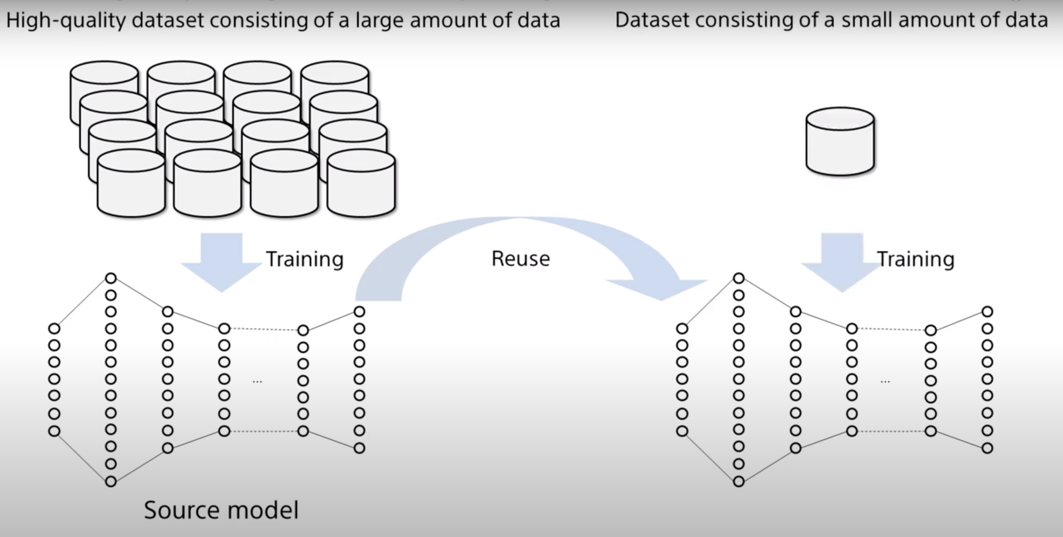

Slide 4
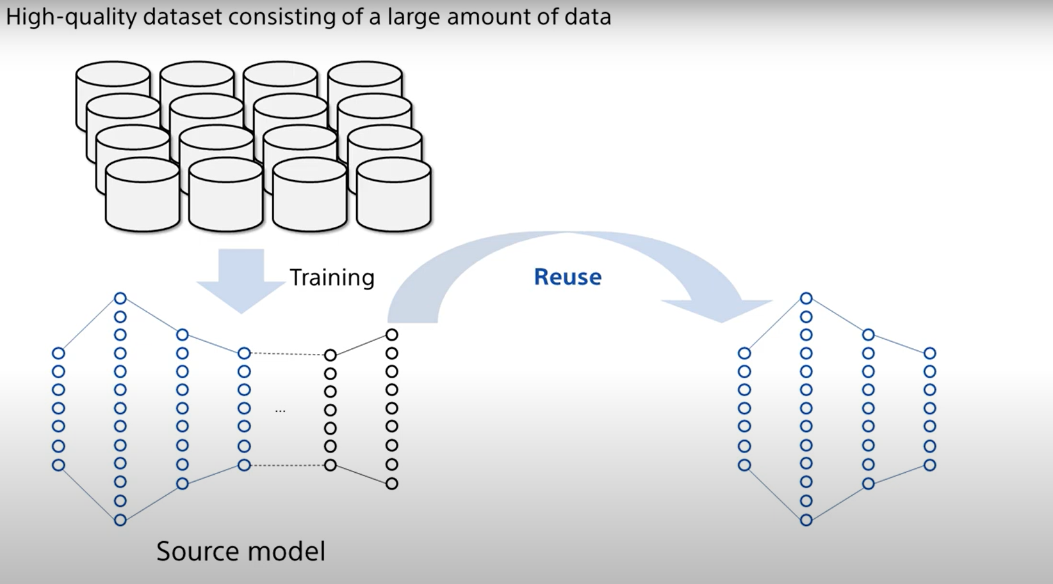

Slide 5
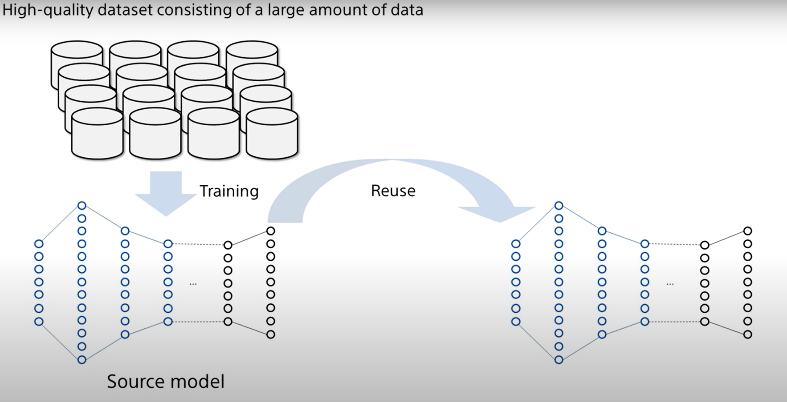

Slide 6
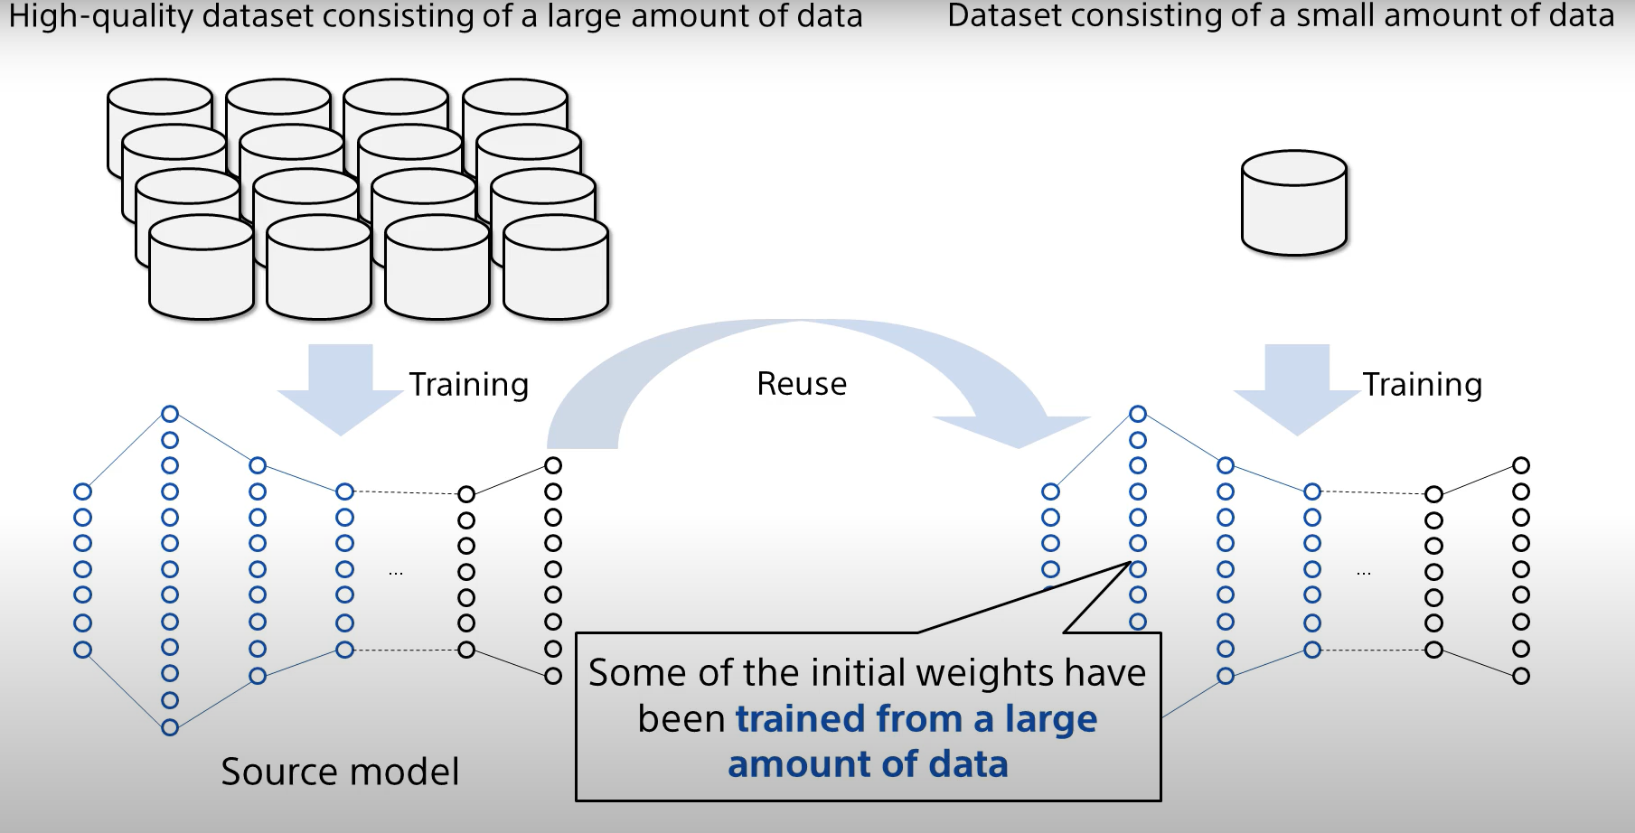

Slide 7
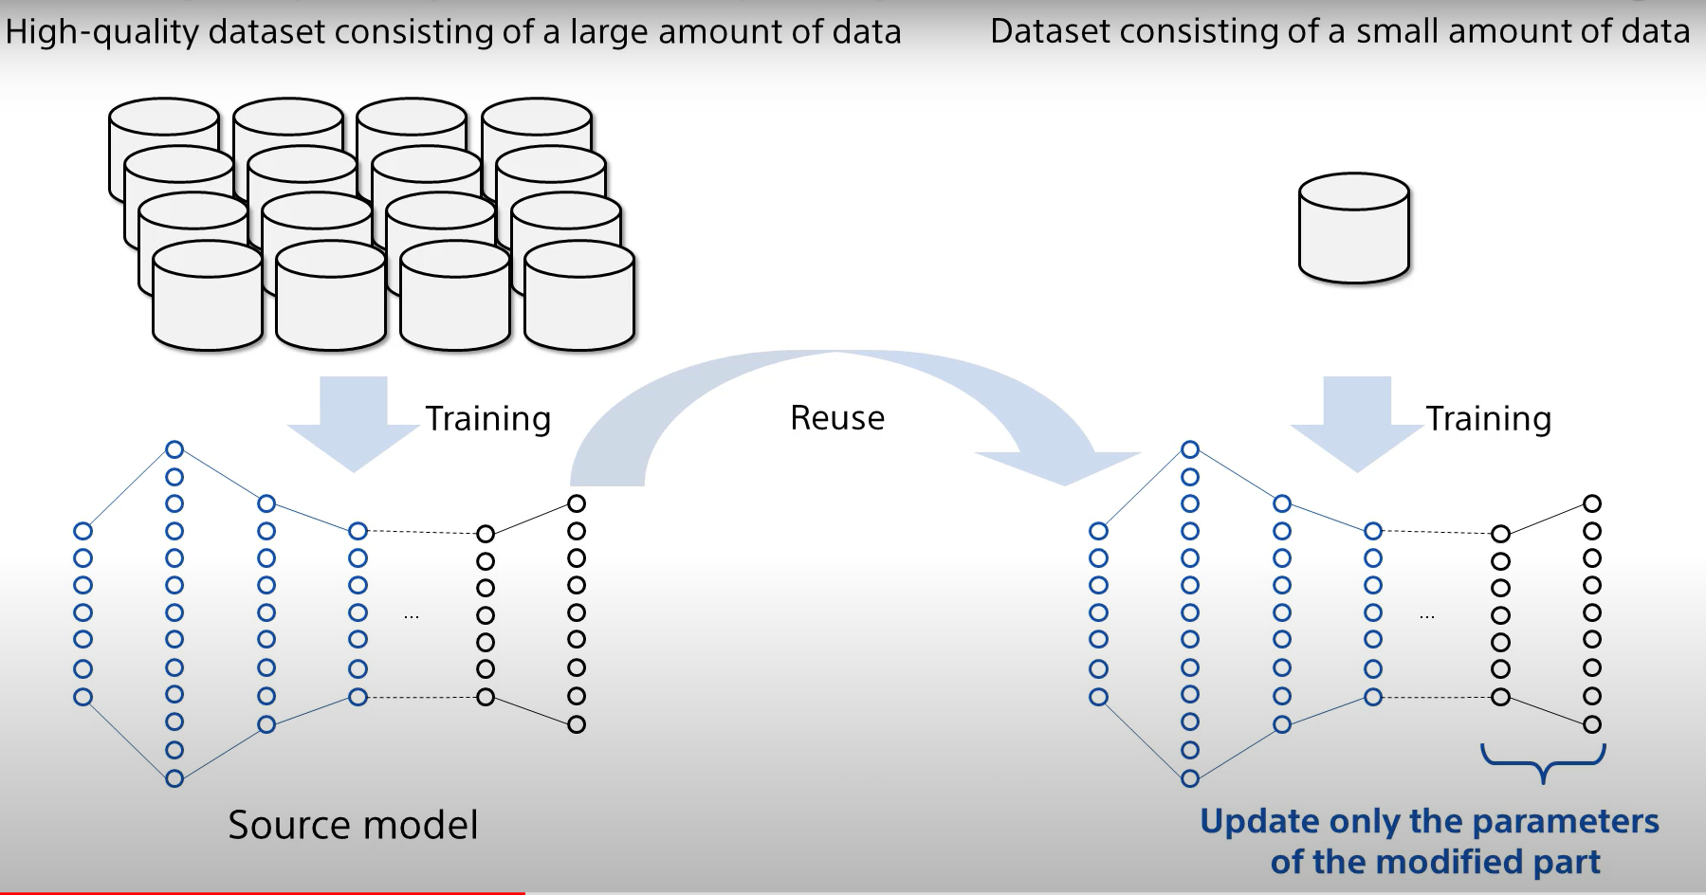

Slide 8
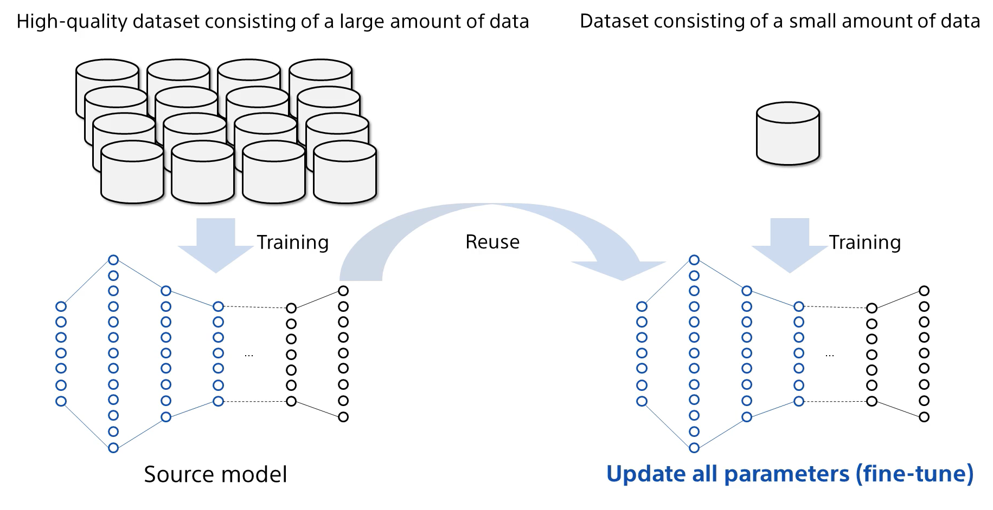

Slide 9
Thankyou

